Slide 1

Actuator based on synchronous motor drive
Sergey Lovlin , Dmitriy Lukichev, Nikolay Polyakov
Faculty of Control Systems and Industrial Robotics , ITMO University , Saint Petersburg

Slide 2
Content
Mathematical description of a synchronous motor without damper winding
Mathematical description of a synchronous motor with permanent magnets
Vector control for PMSM
Brushless DC motor

Slide 3
Mathematical description of a synchronous motor without damper winding
Faculty of Control Systems and Industrial Robotics , ITMO University , Saint Petersburg

Slide 4
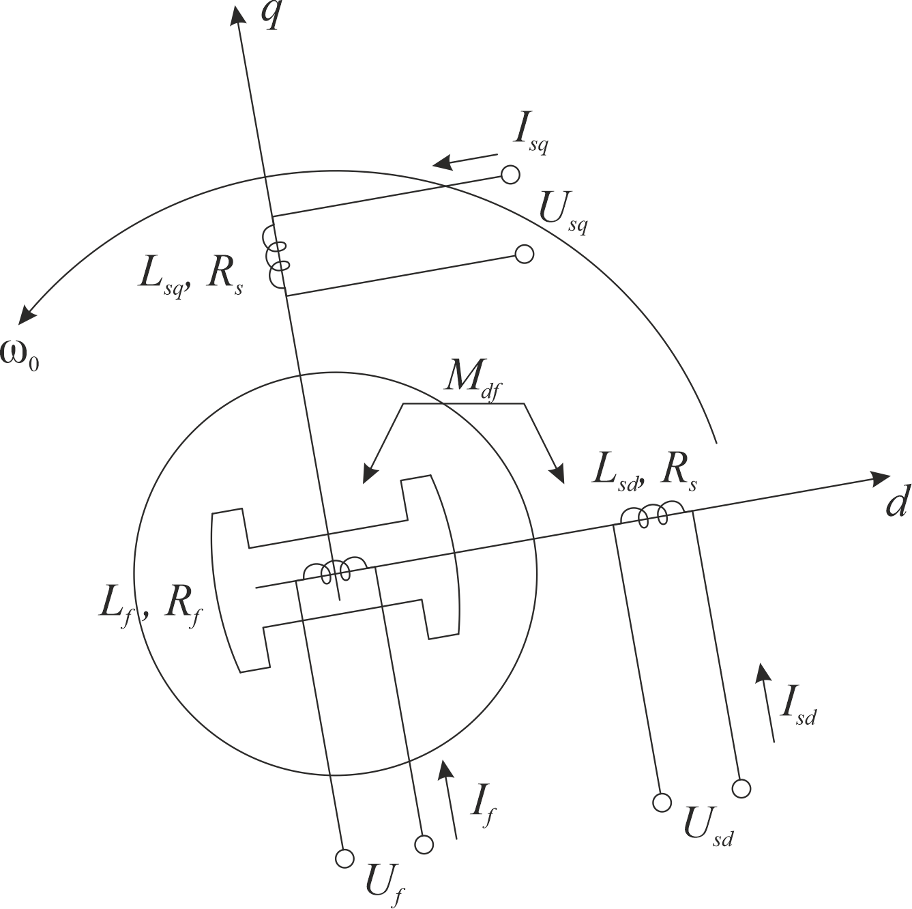
Model of a synchronous motor in a rotating coordinate system
R_{s} – resistance of stator windings
L_{sd} , L_{sq} – stator winding inductances along the d- and q- axes. Special case of non-salient pole design of the motor rotor L_{d} = L_{q} = L_{s}
I_{sd} , I_{sq}, U_{sd} , U_{sq} – stator winding currents and voltages along the d- and q- axes
R_{f} – resistance of excitation winding
L_{f} – inductance of excitation winding
M_{df} – mutual induction coefficient between the field winding and the stator winding along the d axis

Slide 5
Model of a synchronous motor in a rotating coordinate system
Dynamic model:
Ψ_{f} – flux of excitation winding
Ψ_{sd} – flux of stator winding along axis d
Ψ_{sq} – flux of stator winding along axis q
ω₀ – angular frequency of stator voltages
Ω – mechanical speed
ω – electrical speed
Z_{p} – pole pairs

Slide 6
Model of a synchronous motor in a rotating coordinate system
Dynamic model:
Ψ_{f} – flux of excitation winding
Ψ_{sd} – flux of stator winding along axis d
Ψ_{sq} – flux of stator winding along axis q
ω₀ – angular frequency of stator voltages
Ω – mechanical speed
ω – electrical speed
Z_{p} – pole pairs
T_{me} – magnetoelectric torque of synchronous motor

Slide 7
Model of a synchronous motor in a rotating coordinate system
Magnetoelectric torque:
Second Newton’s law:
Ω – mechanical speed
T_{me} – magnetoelectric torque of synchronous motor
T_{dist} – disturbance torque
ω – electrical speed (angular speed of rotor flux Ψ_{f} )
Let’s consider:
Then:
θ – angle of the load (angle between stator flux Ψ_{s} and rotor flux Ψ_{f} )

Slide 8
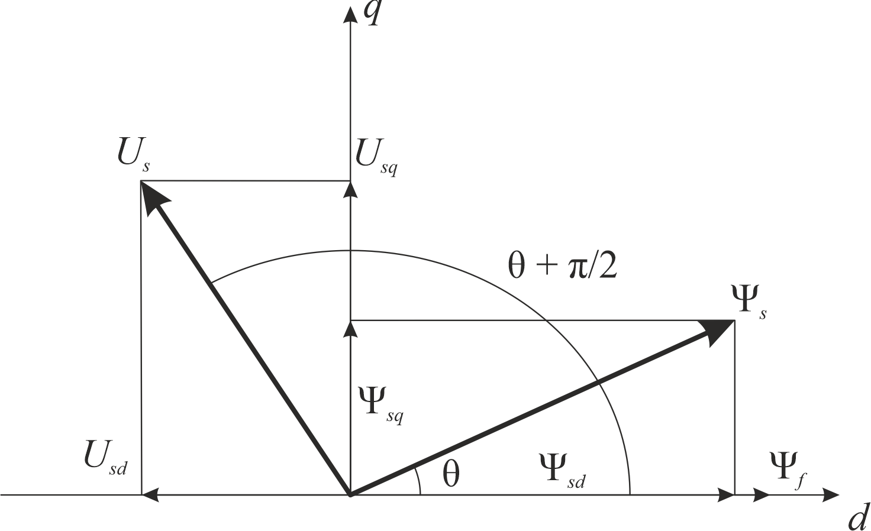
Model of a synchronous motor in a rotating coordinate system

Slide 9
Model of a synchronous motor in a rotating coordinate system

Slide 10
Model of a synchronous motor in a rotating coordinate system
general torque T_{me1}
Reactive torque of a salient-pole motor T_{me2}

Slide 11
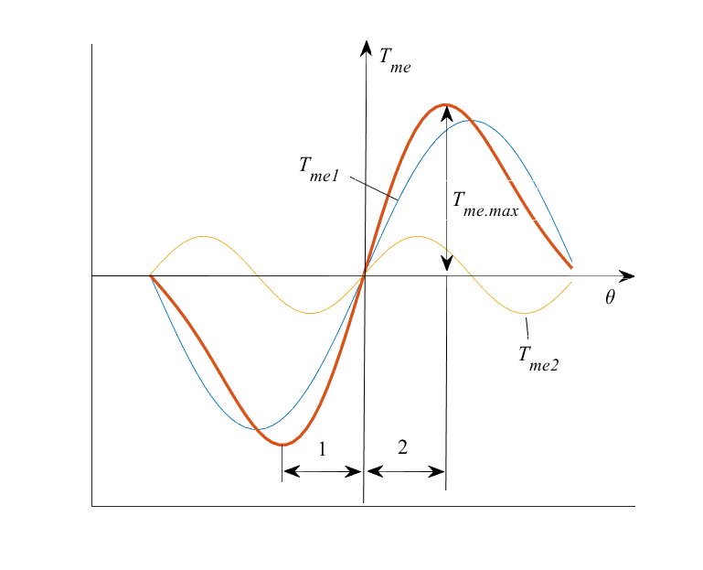
Model of a synchronous motor in a rotating coordinate system
1 - generator mode
2 - motor mode

Slide 12
Model of a synchronous motor in a rotating coordinate system
Let:
Then:

Slide 13
Mathematical description of a synchronous motor with permanent magnets
Faculty of Control Systems and Industrial Robotics , ITMO University , Saint Petersburg

Slide 14
Mathematical description of a synchronous motor with permanent magnets
Assumptions:
- no magnetic circuit saturation, iron losses, current displacement effect
- stator windings are symmetrical
- leakage inductance does not depend on the position of the rotor in space

Slide 15
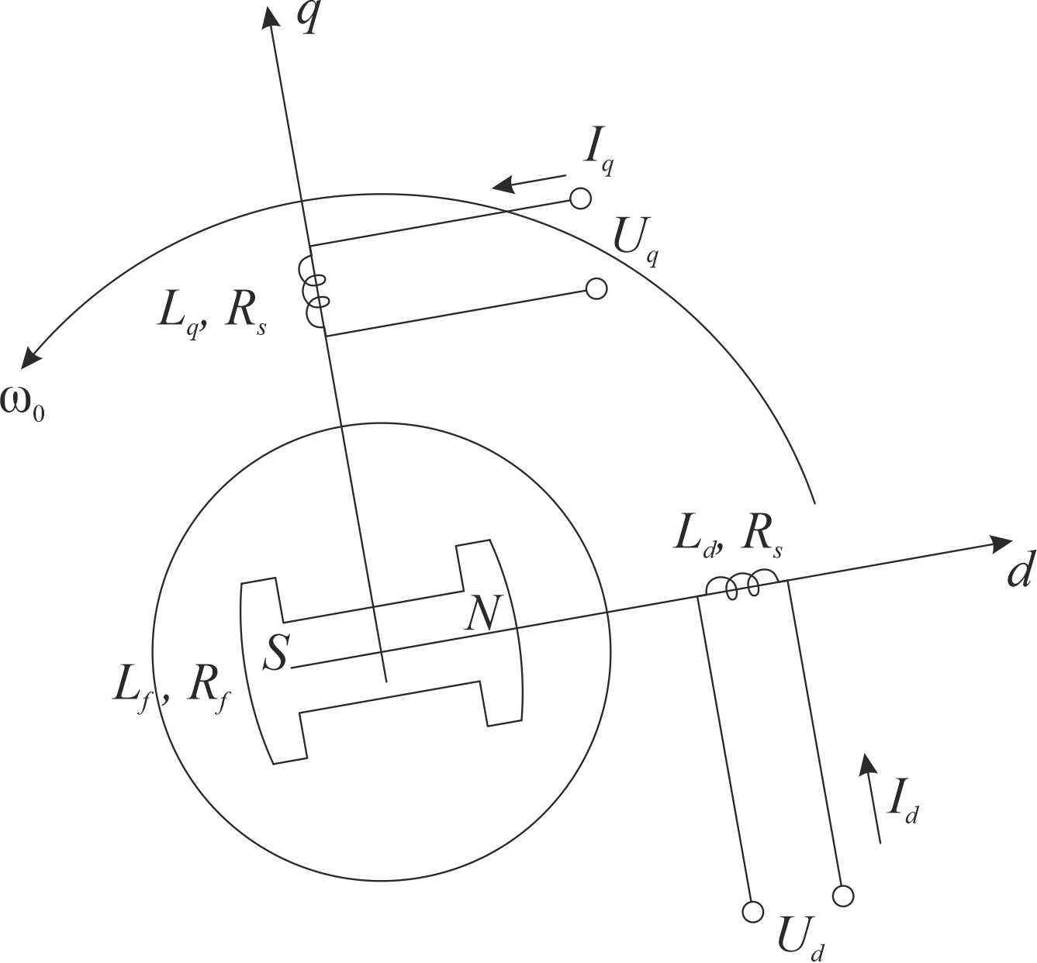
Mathematical description of a synchronous motor with permanent magnets
R_{s} – resistance of stator windings
L_{d} , L_{q} – stator winding inductances along the d- and q- axes. Special case of non-salient pole design of the motor rotor L_{d} = L_{q} = L_{s}
I_{d} , I_{q}, U_{d} , U_{q} – stator winding currents and voltages along the d- and q- axes

Slide 16
Model of a synchronous motor in a rotating coordinate system
Dynamic model:
Ψ_{f} – flux of permanent magnets
Ψ_{d} – flux of stator winding along axis d
Ψ_{q} – flux of stator winding along axis q
J – inertia
β – viscous friction coefficient
Ω – mechanical speed
ω – electrical speed
Z_{p} – pole pairs

Slide 17
Model of a synchronous motor in a rotating coordinate system
Dynamic model:
Ψ_{f} – flux of permanent magnets
Ψ_{d} – flux of stator winding along axis d
Ψ_{q} – flux of stator winding along axis q
J – inertia
β – viscous friction coefficient
T_{me} , T_{dist} – magnetoelectric and disturbance torque
Ω – mechanical speed
ω – electrical speed
Z_{p} – pole pairs

Slide 18
Vector control for PMSM
Faculty of Control Systems and Industrial Robotics , ITMO University , Saint Petersburg

Slide 19
Vector control for PMSM
Field of application:
high-quality electric drive for metal-cutting machines.
Features:
speed control range (D): more than 10000
speed control bandwidth (f_{c}): more than 100 Hz

Slide 20
Vector control for PMSM
Dynamic model:
R_{s} – resistance of stator windings
L_{d} , L_{q} – stator winding inductances along the d- and q- axes. Special case of non-salient pole design of the motor rotor L_{d} = L_{q} = L_{s}
I_{d} , I_{q}, U_{d} , U_{q} – stator winding currents and voltages along the d- and q- axes
J – inertia
β – viscous friction coefficient
Ψ_{f} – flux of permanent magnets
Ω – mechanical speed
ω – electrical speed
Z_{p} – pole pairs
T_{dist} – magnetoelectric and disturbance torque

Slide 21
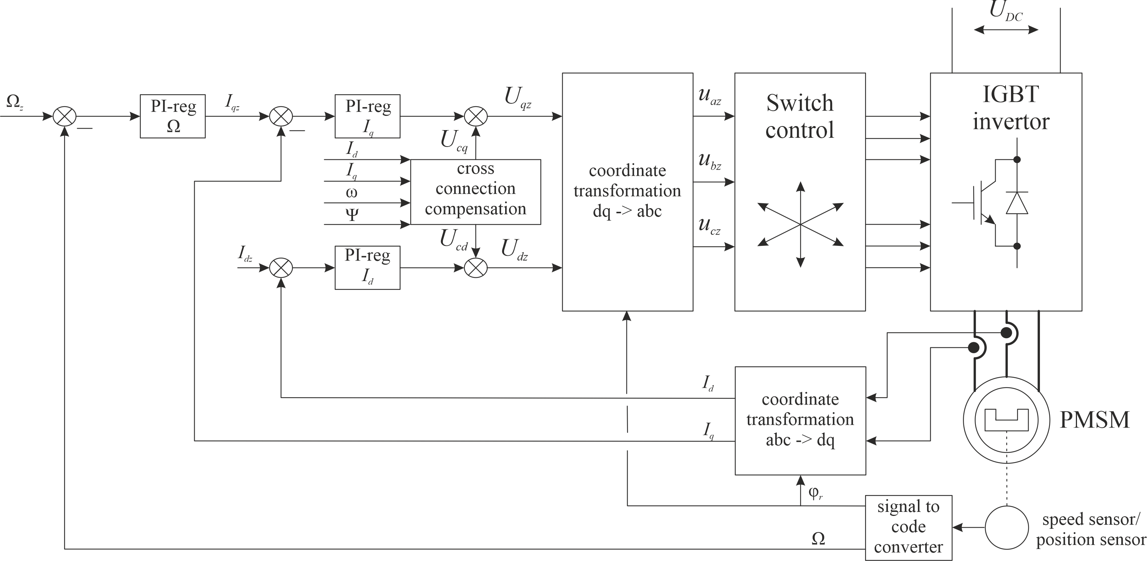
Vector control for PMSM

Slide 22
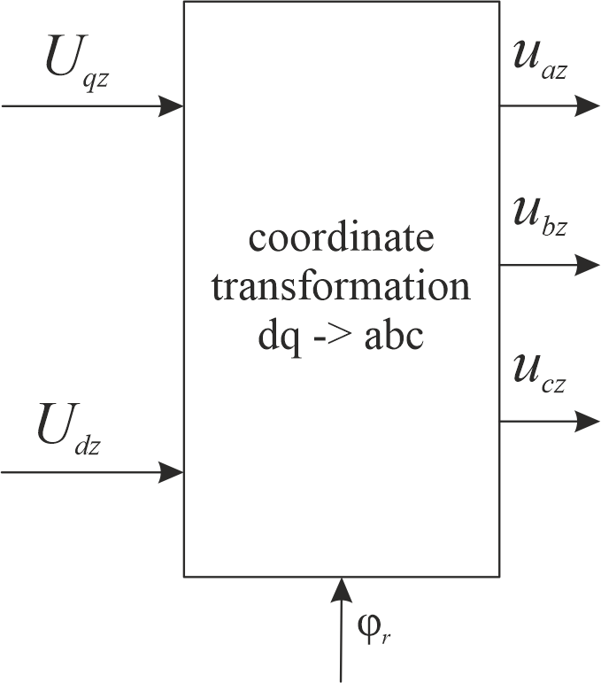
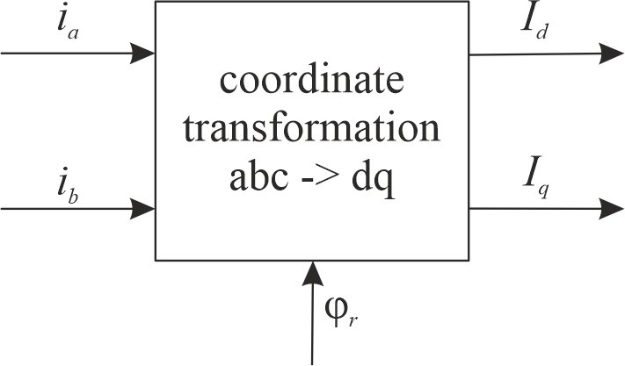
Vector control for PMSM
Coordinate transformation:

Slide 23
Vector control for PMSM
Coordinate transformation:
Let’s assume:
Then:

Slide 24
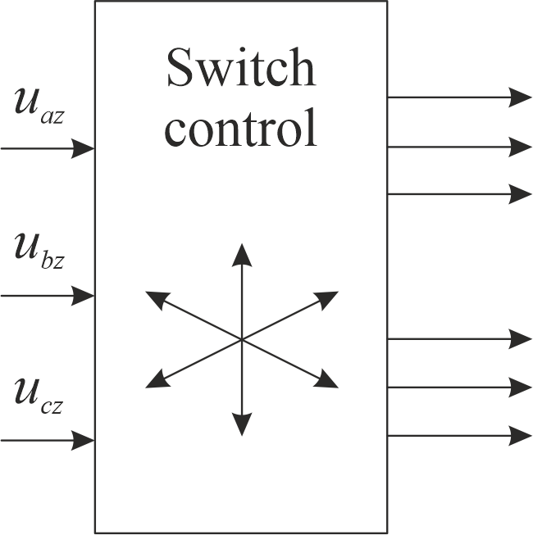
Vector control for PMSM
Switch control:
T_{S} – switching commutation period
t_{a.h}, t_{a.l} – opening time of the upper and lower power switches in phase A
γ_{a.h}, γ_{a.l} – the relative opening duration of the upper and lower power switches in phase A

Slide 25
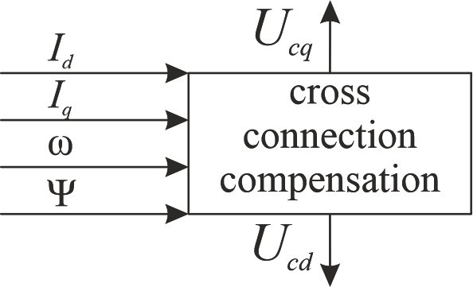
Vector control for PMSM
Cross-connection compensation:
Dynamic model:

Slide 26
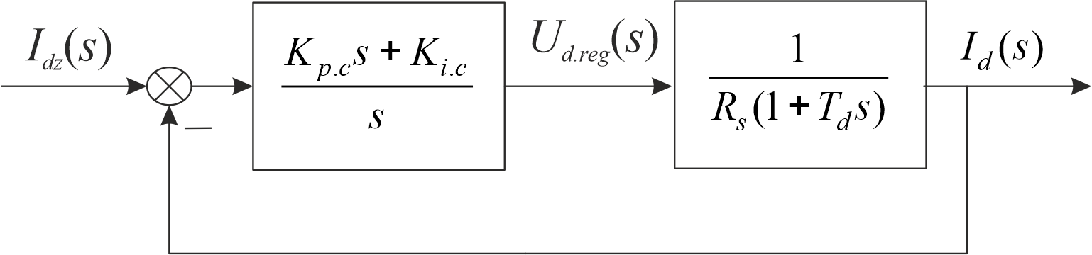
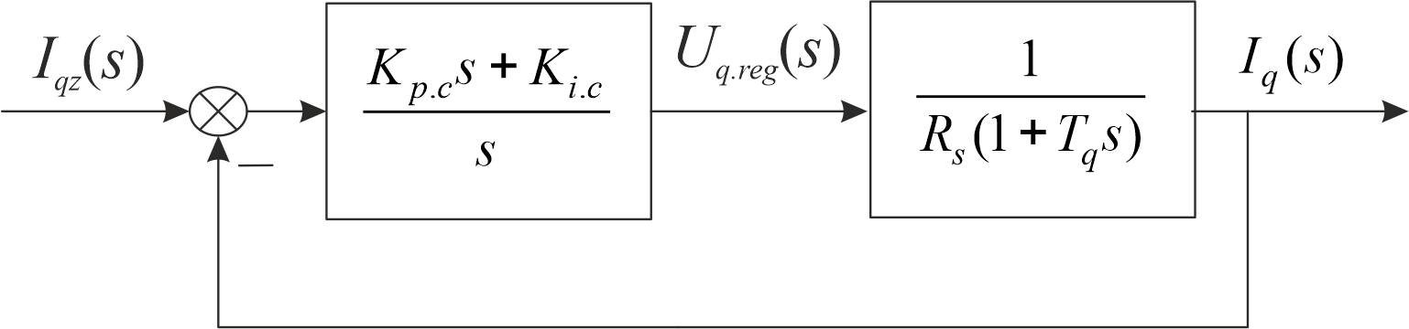
Vector control for PMSM
Current loop for d-axis:
Current loop for q-axis:

Slide 27
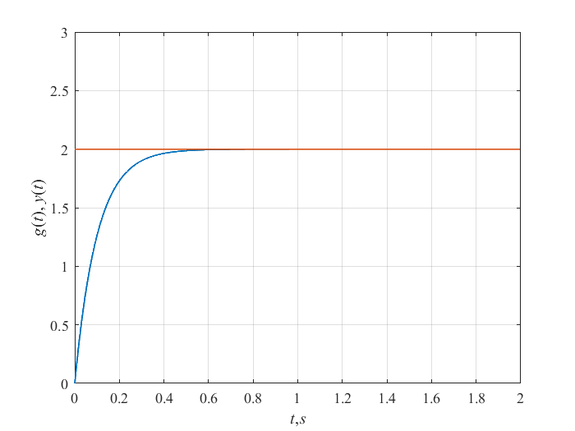
Linear optimum
Astaticism order: | 1
Transient time (95%): | t_{tr} = 3T_{t}
Oscillation index: | M = 1
Overshoot: | δy_{max} = 0
- the desired open-loop transfer function that corresponds to tuning to a linear optimum.
- the desired transfer function of the closed system, which corresponds to the setting for a linear optimum.

Slide 28
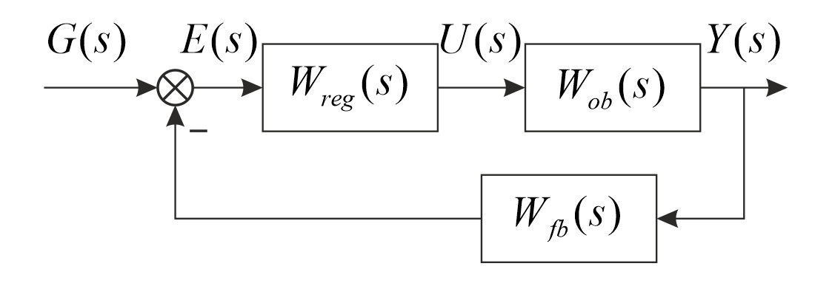
Principle of calculation of regulator parameters
- desired transfer function of the controller.
- transfer function of the object model.
- transfer function of feedback (sensors and measurement channel).

Slide 29
Principle of calculation of regulator parameters
- the desired open-loop transfer function that fits to the desired optimum.

Slide 30
Vector control for PMSM
Calculation of regulator parameters of current loop of d-axis:
- the desired open-loop transfer function that corresponds to tuning to a linear optimum.
- transfer function of the electrical part of motor

Slide 31
Vector control for PMSM
Calculation of regulator parameters of current loop of d-axis:

Slide 32
Vector control for PMSM
Analogically, calculation of regulator parameters of current loop of q-axis:

Slide 33
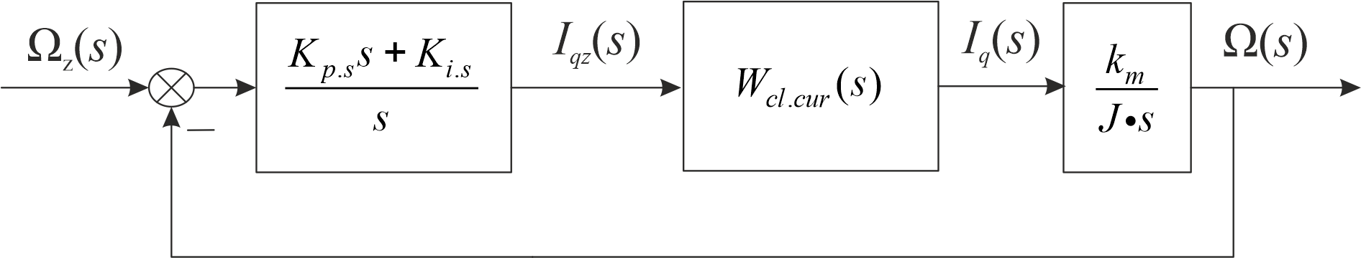
Vector control for PMSM
Calculation of regulator parameters of speed loop :

Slide 34
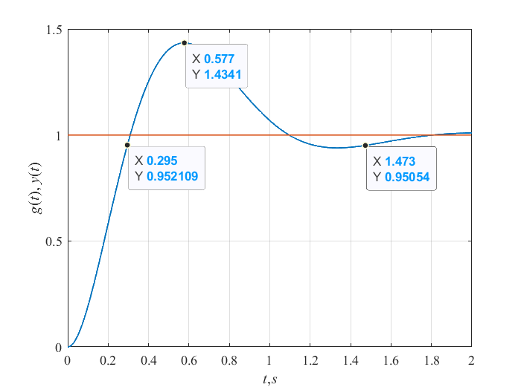
Symmetric optimum
Astaticism order: | 2
Transient time (95%): | t_{tr} = 14.7T_{μ}
Oscillation index: | M = 1.68
Overshoot: | δy_{max} = 0. 43
- the desired open-loop transfer function that corresponds to tuning to a symmetric optimum.
- the desired transfer function of the closed system, which corresponds to the setting for a symmetric optimum.

Slide 35
Vector control for PMSM
Calculation of regulator parameters of speed loop :
- the desired open-loop transfer function that corresponds to tuning to a symmetric optimum.
- transfer function of the electrical part of motor

Slide 36
Vector control for PMSM
Calculation of regulator parameters of speed loop :

Slide 37
Brushless DC motor
Faculty of Control Systems and Industrial Robotics , ITMO University , Saint Petersburg

Slide 38
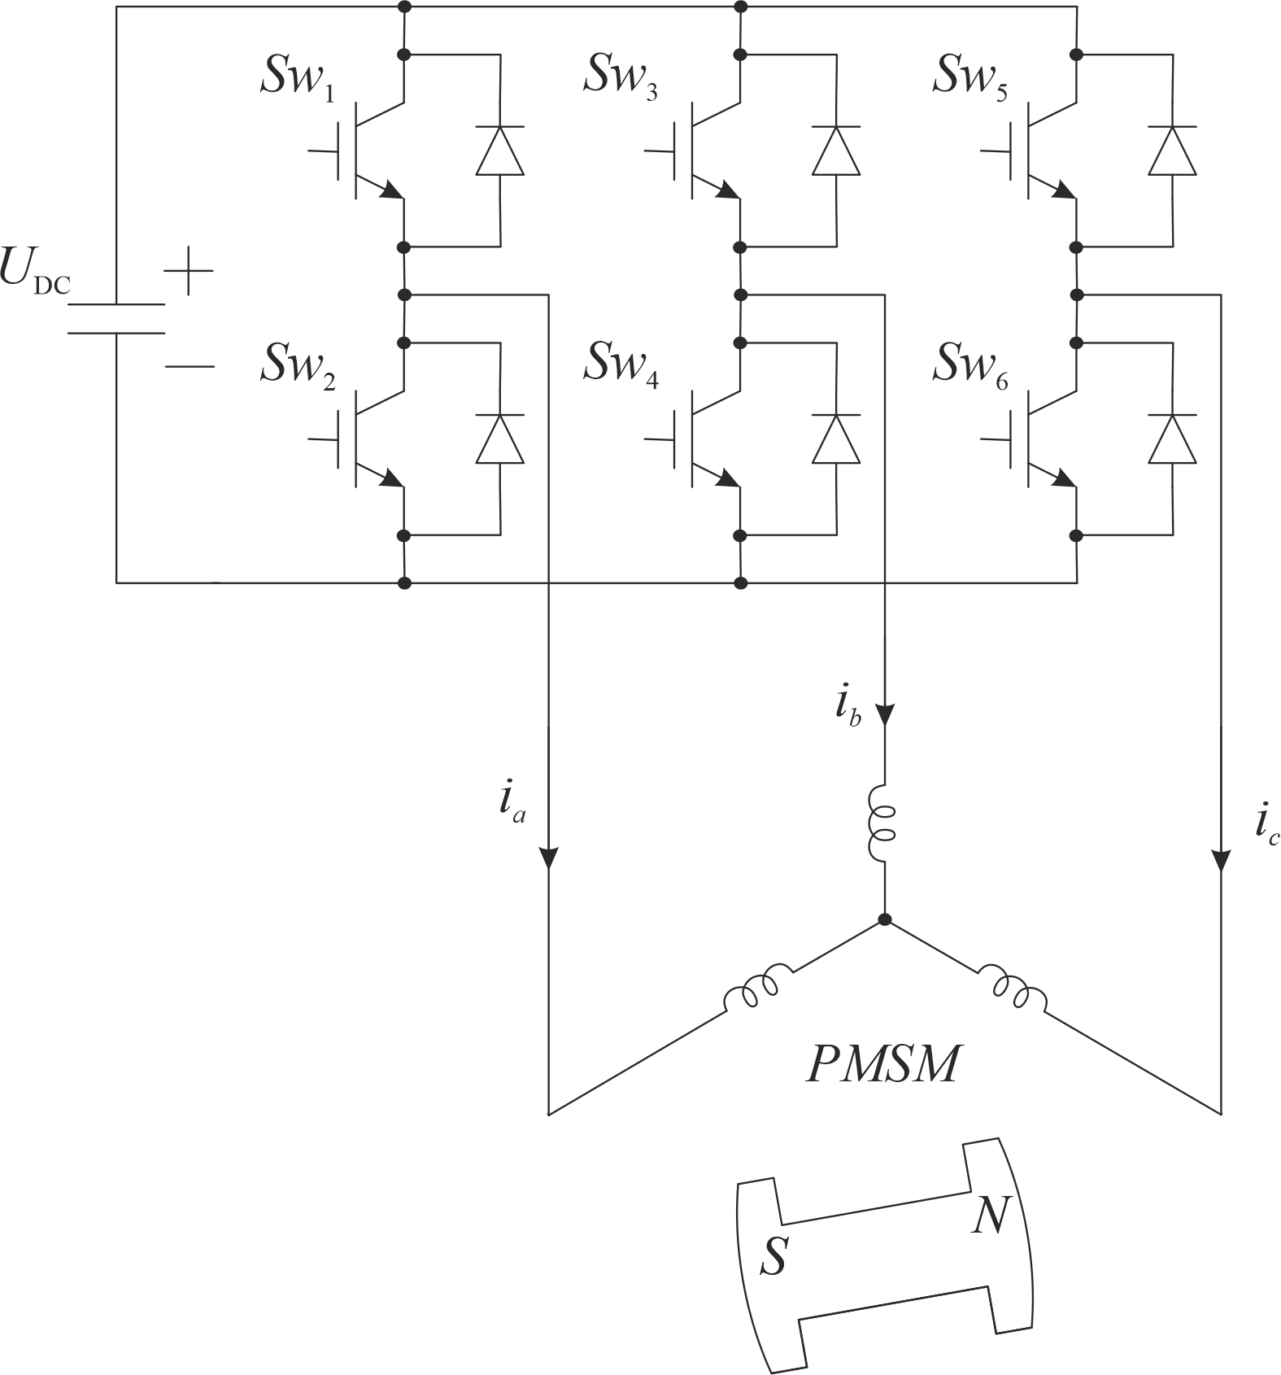
Brushless DC motor

Slide 39
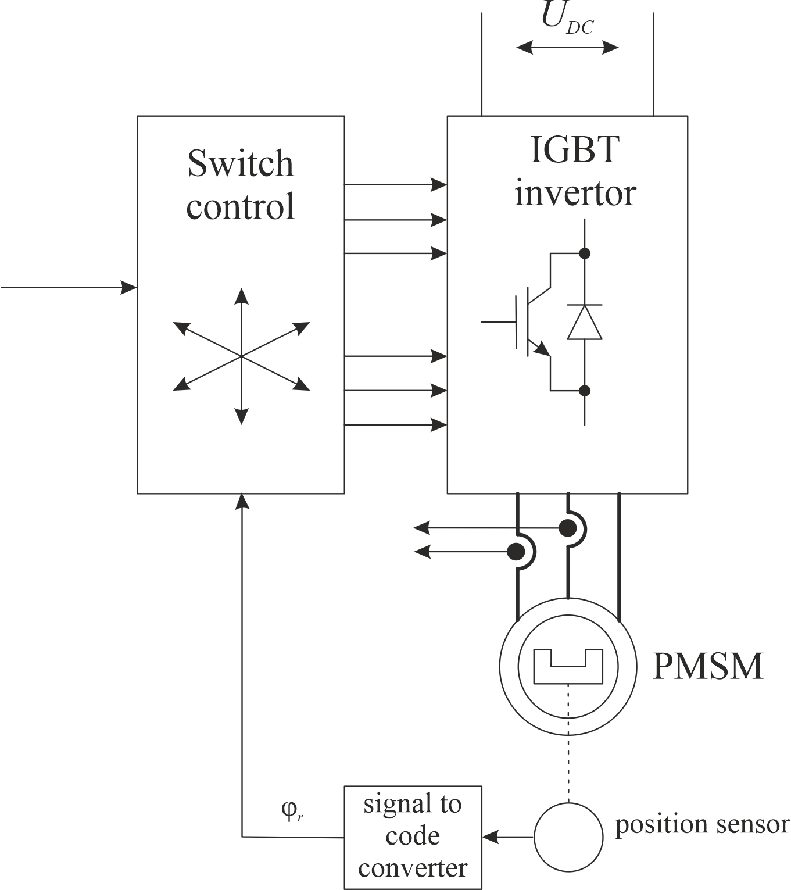
Brushless DC motor

Slide 40
Brushless DC motor
Equations for a three-phase system of motor currents:
R_{s} – resistance of stator windings
L_{s} (φ_{r}) – stator winding inductance.
i_{a} , i_{b}, i_{c}– stator winding currents
u_{a}, u_{b}, u_{c}– stator winding voltages
Back-EMF:
e_{a}, e_{b}, e_{c}– phase back EMFs
c_{e}– back EMF constant
Torque:

Slide 41
Brushless DC motor
Equations for non-salient pole design of the motor rotor:
R_{s} – resistance of stator windings
L_{s} (φ_{r}) – stator winding inductance.
i_{a} , i_{b}, i_{c}– stator winding currents
u_{a}, u_{b}, u_{c}– stator winding voltages
Back-EMF:
e_{a}, e_{b}, e_{c}– phase back EMFs
c_{e}– back EMF constant
Torque:

Slide 42
Brushless DC motor
Torque:
Three phase system of back-EMF:
Let:

Slide 43
Brushless DC motor
Torque:
Three phase system of back-EMF:
Let:

Slide 44
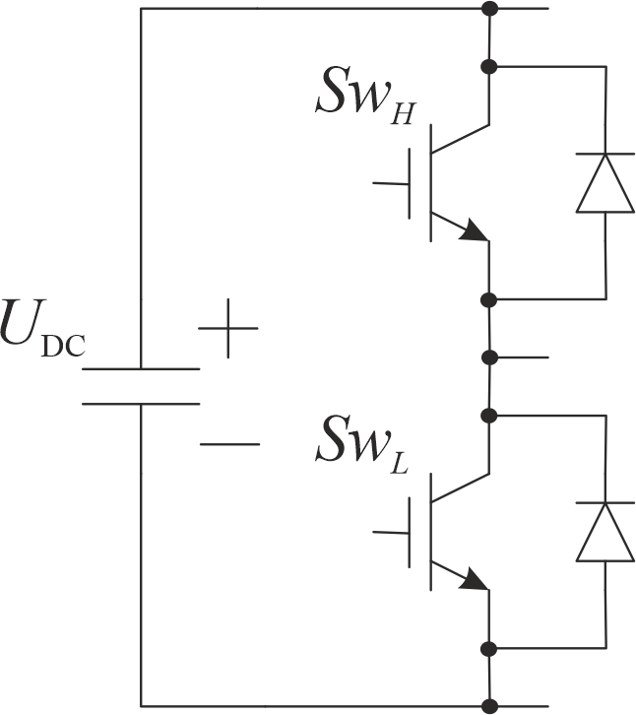
Brushless DC motor
Rack of three-phase inverter:
T_{S} – switching commutation period
t_{h,} t_{l} – opening time of the upper and lower power switches in three-phase inverter rack
γ_{h}, γ_{l} – the relative opening duration of the upper and lower power switches in three-phase inverter rack

Slide 45
Brushless DC motor
Rack of three-phase inverter:
T_{S} – switching commutation period
t_{h,} t_{l} – opening time of the upper and lower power switches in three-phase inverter rack
γ_{h}, γ_{l} – the relative opening duration of the upper and lower power switches in three-phase inverter rack

Slide 46
Brushless DC motor
Rack of three-phase inverter:
Sine pulse-width modulation (SPWM)

Slide 47
Brushless DC motor
Equations for non-salient pole design of the motor rotor with SPWM:

Slide 48
Brushless DC motor
Rack of three-phase inverter:
Space vector modulation (SVM)

Slide 49
Brushless DC motor
Equations for non-salient pole design of the motor rotor with SPWM:

Slide 50
Brushless DC motor
Let’s consider equations for non-salient pole design of the motor rotor with SPWM:
Analogically:

Slide 51
Brushless DC motor
Let’s sum this equations:
Neglecting the last term:

Slide 52
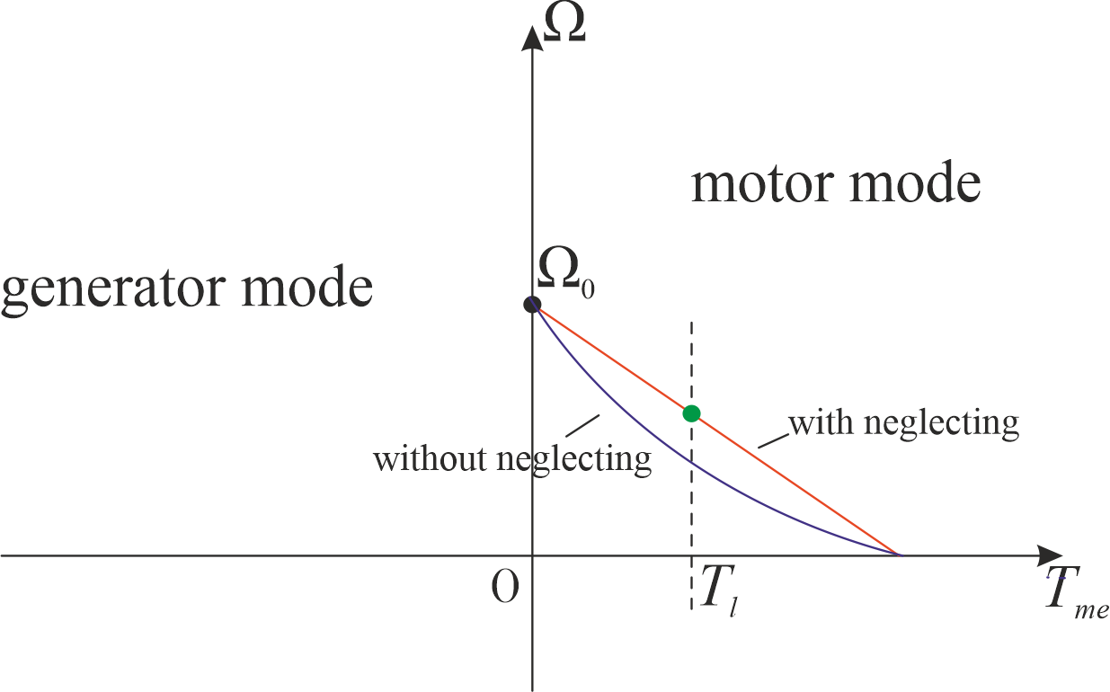
Brushless DC motor
Speed/torque characteristic with neglecting the last term:
Speed/torque characteristic without neglecting last term:

Slide 53
Brushless DC motor
Comparing with vector control
Brushless DC motor:
Vector control:
I_{m} = var
ψ = var
I_{d} = var
I_{q} = var

Slide 54
Brushless DC motor
Brushless DC motor:
Vector control:
Cross connection compensation:
Dynamic model:

